Slide 1
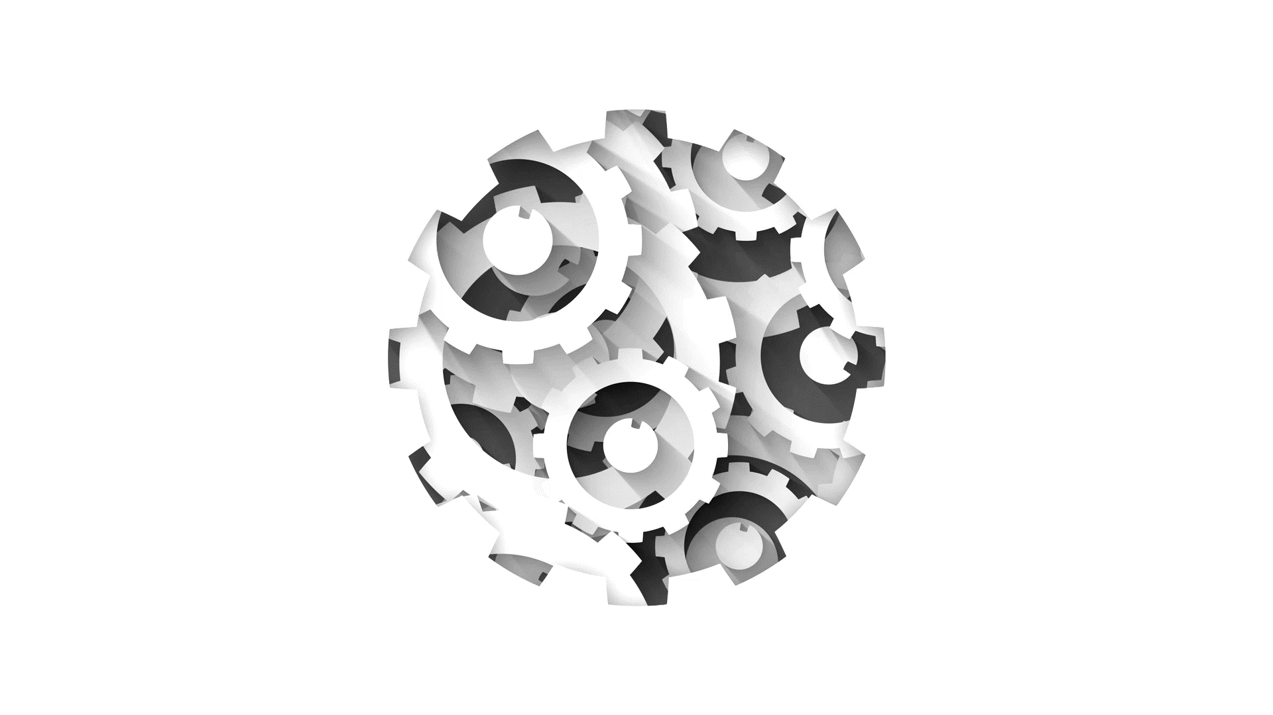


Software Engineering
Lecture 6: Use Cases Modeling (Continuation) by Mohamad Kassab
Leonidas Kontothanassis kthanasi@bu.edu

Slide 2

Lesson OUTLINE
What is a Use Case?
Use Cases Modeling Elements.
Use Cases Guidelines:
Complete Single Goal
Leveled Steps
Technology Neutral
Scenario Plus Fragments
Exhaustive Alternatives
Common Sub Behavior
Interrupts as Extension

Slide 3
What is a Use Case?
The use case technique is used in software and systems engineering to capture the functional requirements of a system.
A use case is a text story that is essentially a group of related scenarios that provide value to the user of a system.
A scenario is one of many paths or a specific sequence within a use case.
For example, an ATM system can have different functionalities (use cases) (e.g., withdrawal, deposit, etc.)
One use case (e.g., withdrawal) can have multiple scenarios:
Standard Withdrawal
Insufficient Funds
Incorrect PIN
Maximum Daily Withdrawal Limit Reached

Slide 4
Use Case Example: Withdraw from ATM
Scenario 1 (Main Success Scenario): Standard Withdrawal
User inserts their ATM card into the machine.
ATM prompts the user to enter their PIN.
User enters the correct PIN.
ATM displays the main menu, and the user selects "Withdrawal" option.
User specifies the amount to withdraw.
ATM checks the account balance and ensures sufficient funds are available.
If funds are available, ATM dispenses the requested amount in cash.
ATM updates the account balance and prints a receipt.
User retrieves the cash and the receipt.

Slide 5
Use Case Example: Withdraw from ATM
Scenario 2 (Alternative Scenario): Insufficient Funds
User inserts their ATM card into the machine.
ATM prompts the user to enter their PIN.
User enters the correct PIN.
ATM displays the main menu, and the user selects "Withdrawal" option.
User specifies the amount to withdraw.
ATM checks the account balance and detects insufficient funds.
ATM displays an error message indicating insufficient funds.
User is prompted to either enter a lower amount or cancel the transaction.
If canceled, the user retrieves their card.

Slide 6
Use Case Example: Withdraw from ATM
Scenario 3 (Alternative Scenario): Incorrect PIN
User inserts their ATM card into the machine.
ATM prompts the user to enter their PIN.
User enters an incorrect PIN.
ATM displays an error message indicating an incorrect PIN.
User is given multiple attempts to enter the correct PIN.
After multiple failed attempts, the ATM retains the card.
User is prompted to contact their bank for assistance.

Slide 7
Use Case Example: Withdraw from ATM
Scenario 4 (Alternative Scenario): Maximum Daily Withdrawal Limit Reached
User inserts their ATM card into the machine.
ATM prompts the user to enter their PIN.
User enters the correct PIN.
ATM displays the main menu, and the user selects "Withdrawal" option.
User specifies the amount to withdraw, which exceeds the daily limit.
ATM displays an error message indicating the daily limit is reached.
User is prompted to enter a lower amount or cancel the transaction.

Slide 8
Why do we need use cases?
Gather requirements
Establishes system boundary, a contractual view of all capabilities expected of the system
Communicate requirements
Bridge gap between the business team and the development team
Manage requirements
Project planning, scheduling and tracking
Controlled delivery of product
Planned Evolution
Verify requirements
Complete list of verifiable functional requirements
Test plans are closely tied to use case scenarios
Notes:
Use cases are a good way to help keep it simple, make it possible for a domain expert (like a banker) to write or participate in writing a use case (ATM system)
Verify the user goals and perspective
Typical num

Slide 9
Typical numbers of use cases
Small project (i.e. single user tool, simple mobile app): 5-20 use cases
Medium project (i.e. small e-commerce sites, workflow automation): 20-50 use cases
Large project (i.e. enterprise system): 100+ use cases

Slide 10
Use Case Modeling Elements
The elements of use case modeling are:
Actors
Use case diagrams
Use case specifications
Use case domain models
Notes:
Actors: Classes of users interacting with the system.
Use case diagram: Stick figures interacting with the system showing how they use it. Simple, does not capture system details.
Use case specifications: The textual description including main success scenario and alternate scenarios of the interaction between users and system
Use case domain models: Structure and concepts inside the system in addition to external users. More details
Answer the entiry-relationship diagram with the domain model comparison.
Concepts/Classes = Tables/Entities
Attributes = Table Columns
Assocations != Relationships (one tell you how the. Data relates, the other tells you how the concepts/classes interact)

Slide 11

Example: University Registration System
A university wants to create an online registration system.
The university registrar sets up the curriculum, students register for courses and the professor requests course rosters.

Slide 12
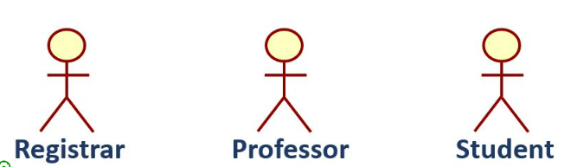
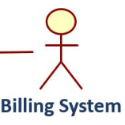
Actors
Actors are external entities that interact with a system.
They define a role played by entities when they interact with a system.
In our example we have the following actors:

Slide 13

Types of Actors
In the context of use cases modeling, there are 3 types of actors:
Primary Actors
Supporting Actors
Off-stage Actors

Slide 14

Primary Actors
Primary actors are the main external entities that directly interact with the system to achieve a specific goal or perform a use case.
They are essential for the success of the use case and have a direct interest in the outcomes.
Primary actors are typically the users or entities initiating the use cases.

Slide 15
Supporting Actors
Supporting actors are entities that provide a service to the system or assist in achieving the goals of a use case.
While not the primary initiators, supporting actors play a supportive role and may interact with the system to facilitate certain processes.
They are not the main focus of the use case but contribute to its execution.

Slide 16
Off-stage Actors
Off-stage actors are external entities that have an interest in the system but do not directly interact with it in the context of a particular use case.
They are relevant for understanding the broader context or external factors that may influence the system.
Off-stage actors are often represented as icons outside the system boundary in a use case diagram.

Slide 17
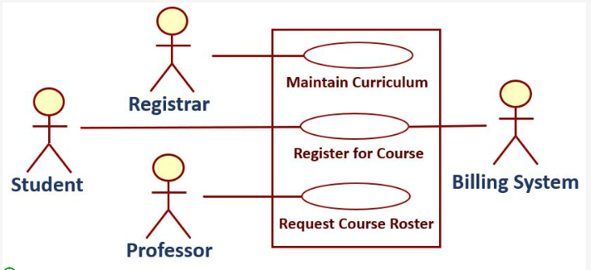
Use Case Diagram
Begin by depicting a system boundary using a rectangle. This boundary encapsulates the entire system.
Place primary actors on the left side of the diagram and supporting actors on the right side of the diagram.
Represent each use case as an oval within the system boundary.
Ensure that the name of each use case starts with a verb, highlighting the action it describes.
Connect the actors to the corresponding use cases using lines, indicating the interactions and relationships between actors and use cases.

Slide 18
Fully Dressed Specification: Use Case Specification
Use Case Specifications include the following items:
Use Case Name
Scope
Level
Primary Actor
Stakeholders and Interests
Pre-Conditions
Success Guarantee (success end condition)
Main Success Scenario
Extensions
Special Requirements
Technology & Data Variation List
Frequency of Occurrence
Open Issues/miscellaneous

Slide 19
Fully Dressed Specification: Use Case Specification
1. Use Case Name
Start with a verb
Example “Buy Item”
2. Scope
The system under design
3. Level
Choose either “user goal” or “subfunction”

Slide 20
Fully Dressed Specification: Use Case Specification
4. Primary Actor
The principal actor that calls upon a system service to fulfill a goal
5. Stakeholders and Interests
Interests of the actors a use case must satisfy
6. Preconditions
Conditions that must be true before a use case can be executed. Example
Registrar is identified and authenticated

Slide 21
Fully Dressed Specification: Use Case Specification
7. Success Guarantee
Conditions that must be true after the use is executed and successful Example
For example; Curriculum for a semester is saved

Slide 22
Fully Dressed Specification: Use Case Specification
8. Main Success Scenario
Focus on what not on the how
Example:
1. Registrar enters the semester
2. System presents course catalog
3. Registrar selects a course
4. System prompts for course offerings
5. Registrar assigns sections and times
Registrar repeats steps 3-5 until done
6. System saves the semester curriculum
Do not repeat pre-conditions

Slide 23
Fully Dressed Specification: Use Case Specification
9. Extensions
Alternate scenario paths such as
Exception conditions (failure conditions)
Alternate scenarios of success
Example
*a. At any time, system fails
1. Registrar starts again from the point of failure
2a. Incorrect semester
1. System signals error and rejects entry

Slide 24
Fully Dressed Specification: Use Case Specification
10. Special Requirements
Non-Functional requirements, quality attributes or constraints such as
Static and dynamic performance requirements
Usability
Design constraints
Example
Registrar must be able to create curriculum offline and upload it into the system when ready

Slide 25
Fully Dressed Specification: Use Case Specification
11. Technology & Data Variation List
Variations in technology
12. Frequency of Occurrence
13. Open Issues/Miscellaneous
Dynamic list of current unresolved issues
Variations in data
When & how often a use case will be used
Min,max and average
Number of times per actor per day
Example: This activity occurs for a week 4 months prior to the beginning of a semester. 10 concurrent users create curriculum consisting of 900 course sections
Notes:
The Technology and Data Variation allows you to add special cases that may be affected by choice of technology and how data is available without affecting the main scenario.
For example you can accept many different types of payments or receive data from different sources and in different formats but don’t want to clutter the main scenario with that information.
Open issues is a catch all for things not known: Example should we allow guest checkouts in our alternate scenarios, how should shipping costs be calculated, etc.

Slide 26
Partially Dressed Specification: Use Case Specification
A partially dressed use case is often seen as a simplified or abbreviated version of a fully dressed use case.
What is a Partially dressed use case?
It may only contain the use case name, main success scenario, and extensions sections only.

Slide 27
Useful Use Case Guidelines
Complete Single Goal
Leveled Steps
Technology Neutral
Scenario Plus Fragments
Exhaustive Alternatives
Common Sub Behavior
Interrupts As Extensions
Notes:
Explained on upcoming slides

Slide 28
1. Complete Single Goal
Improper goals will leave the writers deciding where one use case ends and another begins.
Write each use case to address one complete and well-defined goal.
That goal may be at any level in an Ever Unfolding Story

Slide 29
2. Leveled Steps
Excessively large or excessively small use case steps obscure the goal and make the use case difficult to read and comprehend.
Each scenario should have 3 to 9 steps. Ideally, they are all at similar levels, a level of abstraction just below the use case goal.
Notes:
Steps in the main success scenario – it is the path that satisfies the interests of the stakeholders
The level of complexity by which a system is viewed. The higher the level, the less detail. The lower the level, the more detail. The highest level of abstraction is the single system itself. The next level would be only a handful of components, and so on, while the lowest level could be millions of objects.
Lets look at some examples

Slide 30
Use Case Horror: Small steps
USE CASE: Purchase Goods
Primary Actor: User – Customer wanting to make purchase.
Main success scenario:
1. System asks user for first name.
2. User enters first name.
3. System asks for middle initial.
4. User enters middle initial.
5. System asks for last name.
6. User enters last name.
7. System asks for first line of street address.
... (etc....!!!)
Too long and tedious!

Slide 31
Use Case Horror: Large steps
USE CASE: Purchase Goods
Primary Actor: Visitor – Customer wanting to make purchase.
Main success scenario:
1. Visitor enters all the customer, product and purchase information.
2. System presents visitor with final sums, charges credit card and delivers packing list to the shipping department.
The scenario doesn’t tell us anymore than we can deduce from the name!

Slide 32
Use Case Horror: Mixed steps
USE CASE: Purchase Goods
Primary Actor: User – Customer
Main success scenario:
1. The system displays the Login screen.
2. User enters a username and password.
3. The system verifies the information.
4. The system sets access permissions.
5. The system displays the Main screen.
6. User does one or more of the following: Place Order, Return Product, Cancel Order, Send Catalog, Register Complaint.
7. The system terminates the session and reset the screen.
Step 6 is at a vastly different scale than steps 1-5

Slide 33
Solution: Aim for 3-9 steps
USE CASE : Purchase Goods
Primary Actor: Visitor – Customer wanting to make purchase.
Main success scenario:
1. Visitor enters customer information (name, address, etc.).
2. System retrieves customer's profile information, and presents product search and selection mechanisms.
3. Visitor selects products until satisfied. After each selection, system adds the selected product to the customer's "shopping cart" and presents the ongoing running total of products selected.
4. Visitor selects to purchase the selected items.
5. System presents contents of shopping cart, requests customer's payment information.
6. Customer enters manner of payment and other payment details.
7. System presents visitor with final sums, charges credit card and delivers packing list to the shipping department.

Slide 34
3. Technology Neutral
Including technology constraints and implementation details in a use case description increases the complexity and obscures the goal of the use case.
Write each use case in a technology neutral manner.

Slide 35
Use Case Horror: Too Much Technology
USE CASE: FILE ACCIDENT CLAIM
Primary Actor: Claimant – policyholder reporting accident claim
Main success scenario:
1. Claimant accesses Accident Reporting System
2. Claimant identifies self to system using name and policy number
3. System verifies claimant owns a valid policy against policy database.
4. Claimant submits claim with substantiating data including name of both parties, investigating officer, and citation number, if applicable
5. System logs claim file and policy database, and sends email acknowledgement to the claimant
This example contains at least three flaws:
It presupposes the system will store policy information in a database.
2. It presupposes the system will store claim information in a data file.
3. It presupposes the system will send email to acknowledge a claim.
Notes:
This example contains at least three flaws:
It presupposes the system will store policy information in a database.
2. It presupposes the system will store claim information in a data file.
3. It presupposes the system will send email to acknowledge a claim.

Slide 36
Solution: Technology Neutral
USE CASE: FILE ACCIDENT CLAIM
Primary Actor: Claimant – policyholder reporting accident claim
Main success scenario:
1. Claimant accesses Accident Reporting System
2. Claimant identifies self to system using name and policy number
3. System verifies claimant owns a valid policy.
4. Claimant submits claim with substantiating data including name of both parties, investigating officer, and citation number, if applicable
5. System logs claim and acknowledges its receipt to the claimant
6. Requestor: mark request delivered.

Slide 37
4. Scenario Plus Fragments
The reader must be able to easily follow the path through the specific scenario or story that they are interested in, otherwise they are likely to become frustrated or miss important information.
Write the success storyline as a simple scenario without any consideration to possible failures. Below it, place story fragments that show what alternative condition might have occurred.
Notes:
Complex or long alternatives clutter a use case and can obscure other alternatives. A use
case can become difficult to write and even more difficult to follow when the alternatives are
too long or complex, and cannot be easily written as a main scenario plus fragments.
Example coming up

Slide 38
5. Exhaustive Alternatives
A use case may have many alternatives. Missing some means the developers will misunderstand the system's behavior and the system will be deficient.
Capture all failure and alternatives that must be handled in the use case.

Slide 39
A comprehensive use case
Use Case: Access Email Main success scenario 1. User initiates use case by logging on to the system and requesting email. 2. Server displays user’s email screen. 3. User and server repeat the following sequence indefinitely. 4. User selects email. 5. Server display email, and marks it read. 6. User selects “quit” option. 7. Server updates user’s email account information and logs off user. | Alternate Scenarios User saves email 4. User selects “Save Email” option. 5. Server marks email as unread. User replies to email 4. User selects “reply” option. 5a. Server prompts user for a reply. 5b. User enters reply and instructs server to send email. 5c. Server sends email to address of message’s originator. User forwards email to another user 4. User selects “forward Email” option. 5a. Server requests address. 5b. User supplies information and instructs server to send email. 5c. Server forwards email to specified address. Error Scenarios Invalid Login 1. User supplies incorrect login id or password. 2. Server displays error message and initiates a new login sequence.
Notes:
Example of both “scenario plus fragments” (alternative conditions) and “exhaustive alternatives”
Many alternatives plus error/failure conditions.

Slide 40
6. Common Sub Behavior
Writing the same steps for different use cases is wasteful and makes it more difficult to see common sub-processes within a use case model.
Express shared courses of actions with <<included>> use cases.
Notes:
Includes and extends were originally intended to simplify the use case model by collecting
common threads in the use case model.

Slide 41
Common Sub Behavior (Example)
Use Case 1: Book a Flight
Description:
User selects "Book a Flight" option.
User provides travel details including departure and destination airports, travel dates, and passenger information.
System checks for available flights based on user input.
User selects a preferred flight option.
System prompts the user for payment information.
Call Collect Payment Information

Slide 42
Common Sub Behavior (Example)
Use Case 2: Book a Cruise
Description:
User selects "Book a Cruise" option.
User provides cruise details such as destination, departure date, cabin preferences, and passenger information.
System displays available cruise options.
User selects a preferred cruise package.
System prompts the user for payment information.
Call Collect Payment Information

Slide 43
Common Sub Behavior (Example)
Use Case 3: Collect Payment Information
Description:
User initiates a payment process (e.g., during flight or cruise booking).
System prompts the user for payment information.
User provides payment details such as credit card information.
Payment Gateway validates and processes the payment.
System updates the booking status based on the payment result.
If payment is successful, the system confirms the booking; otherwise, it provides an error message.

Slide 44
Common Sub Behavior
Book Flight
<<include>>
Collect Payment Information
<<include>>
Book Cruise
In a use case diagram, the "<<include>>" stereotype is used to indicate that one use case includes the functionality of another use case.
It signifies a relationship between the base use case (the included one) and the inclusion use case (the one doing the including).
Notes:
The appropriate application of include is to eliminate redundancy that would otherwise make the set of use cases difficult to understand. If two or more use cases have a set of steps in common, then rather than rewriting those steps, we can collect them into a common use case. Here, both Book Cruise and Book Flight use “collect payment information”. No matter what kind of trip we are booking, we always collect payment the same way, so why write the same thing twice?

Slide 45
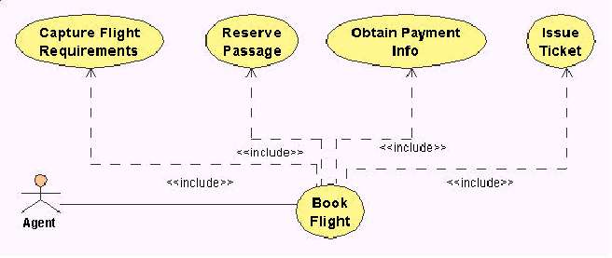
Don’t Do This!
Misuse of <<include>> to create a director style use case.
Use Case: Book Flight:
1. The use case begins when the agent selects set travel itinerary. Call Capture Flight Information to get the travel itinerary.
2. The agent chooses select flight. Call Reserve Passage to reserve a flight segment.
3. The agent chooses book flight, Call Obtain Payment Information to get payment choice.
4. Call Issue Ticket to print ticket.
Think of each use case like a chapter in a novel. Including another use case mid-way is like cutting to an entire other chapter instead of summarizing a short scene inline. You can do it—but it needs to serve the story, not disrupt it. A use cases consisting entirely of others would be terrible reading.
Notes:
Director style: a use case that depends on several included use cases.
Use case book flight is including “capture flight requirements”, “reserve passage”,…..use cases
Includes and extends should only be used when they simplify things, not make things more
complicated and confusing.
Furthermore, people frequently tend to use these relationships to create director style use
case, in which extension use cases specify the details of each step. The consequence of this
technique is that usually the model represents the developer’s point of view, causing
the readers to lose sight of the important actor goal in the details.
Just use actor and book flight!
The problem is that the included use cases in this case are trivial – they are too simple and small to justify their existence as entire use cases

Slide 46
7. Interrupts As Extensions
An alternative that affects more than one step in a scenario can scatter related details throughout a use case, causing the reader to become confused or lose track of important information.
Create an extension use case when an alternative course of action interrupts a number of steps in a scenario.

Slide 47
Use case horror: Confusing alternatives
Alternatives:
2a: Client is frequent flier:
2a1 The system retrieves the client’s profile and displays the flights sorted by client’s airline preference.
4a: Client is a frequent flier:
4a1 The system offers premium seats for the client.
4b: Seat is not available in ticket category
4b1: The system informs the agent that no seats are available in the client’s chosen price category.
4b2: The agent specifies another price preference.
4c: Seat is not available (flight fully booked)
4c1: The system informs agent that no seats are available at all.
4c2: The agent specifies another set of departure time preferences.
4d: Client is a frequent flier and seats are not available.
4d1 The agent puts the client on a priority wait listed for the seats.
5a Client is a frequent flier
5a1: The system verifies client has upgrade coupons in their account.
5a2: The system wait lists the client for upgrade on the flight.
Use Case: Book Flight:
1. The use case begins when the agent specifies a travel itinerary for a client.
2. The system searches a set of appropriate flights and presents them to the agent.
3. The agent chooses select flight.
4. The system verifies space is available on the flight and reserves a seat on the flight.
5. The agent finalizes the booking by supplying payment information.
6. The system books the seats, and issues the ticket.
Notes:
Main success scenario is straightforward – agent builds a travel itinerary for a client.
However, there are many extensions if the client is a frequent flier because of privileges and services that are available to them.
In this example, its too easy for the reader to forget that all the individual frequent flyer alternatives listed in the use cases alternatives section represents the thread of an ongoing alternative course of action.
This can be clarified by using extensions – collecting all the frequent flyer alternatives together

Slide 48
Solution: Use extension use cases
Use Case: Book Flight for Frequent Flier
Extends Book Flight
2a1 The system retrieves the client’s profile and displays the flights sorted by client’s airline preference.
4a1 The system offers premium seats for the client.
5a1: The system verifies client has upgrade coupons in their account.
5a2: The system wait lists the client for upgrade on the flight.
Alternatives:
4d: Client is a frequent flier and seats are not available.
4d1 The agent puts the client on a priority wait listed for the seats.
Notes:
The thread of an interrupting alternative is kept together and therefore the reader can
see the context of the alternative (one stop shopping principle).
• The original or base use case is not cluttered with interrupting alternatives.

Slide 49
7. Interrupts As Extensions
In a use case diagram , the "<<extends>>" stereotype is used to indicate that one use case can extend the behavior of another use case under certain conditions.
It signifies a relationship between the base use case (the one being extended) and the extending use case.

Slide 50
System Sequence Diagrams
Identify behavior whose implementation is to be specified
Details:
Model roles
Model lifelines
Model activations
Model messages
Notes:
-Sequence of events between the actor and the whole system
-a picture that shows one particular scenario of a use case
-events the actor generates, their order, and intersystem events
Use case isnt’ enough – good for showing externally visible behavior
Add precision to System operations (i.e. what inputs does an operation need and what outputs it provides)
Much easier to be clear on who (user vs system) owns what
Easier to see sequence, loops, alternatives, timing of operations. Important is multiple actors involved
Easier to derive APIs from them than use cases
Better able to see alternate scenarios

Slide 51
System Sequence Diagram
Displays the lifeline of a participating object as they exchange messages in a single scenario
Participating object:
Does some action
Puts results of action in a message
Sends message to another object
The message sequence is emphasized – easy to understand interactions!!
Notes:
Goals of a SSD
A scenario remember is an instance of a use case

Slide 52
Example: Register for Courses
Notes:
System as a black box – the underline and : represent that it is an instance.
3 messages sent to the system
Student can select semester list and course list several time.
System sends bill request message to billing system class
Notice the activation bars – system active when it gets request from student.

Slide 53
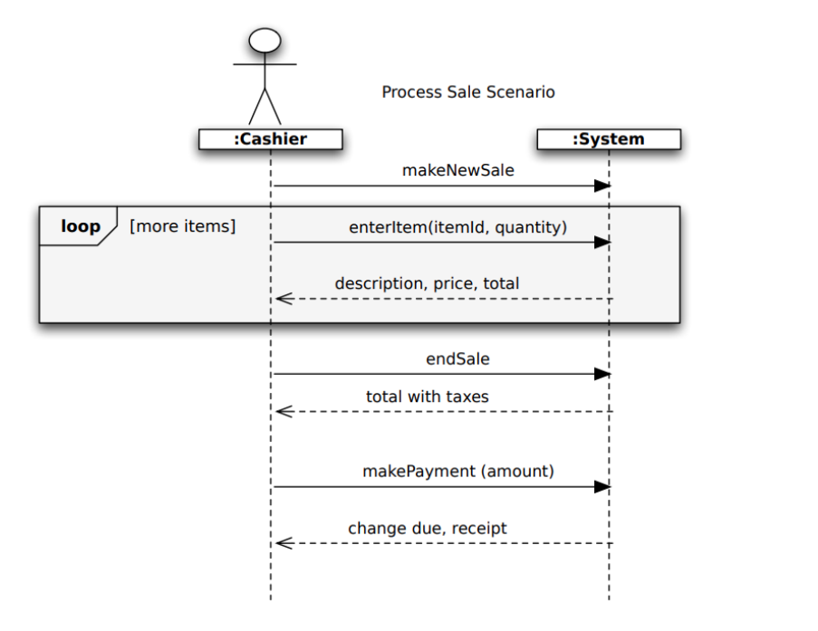
Example: Process Sale Scenario

Slide 54
Roles
The role name (objects) instanced is usually anonymous.
The class name follows after the colon.

Slide 55
Lifelines
Represent existence of objects over a period of time
: Student
lifelines
Destruction (Optional)
Notes:
Noticed the participating object: Role: class
-Lifeline or object lifeline is a vertical line under object or actor to show passage of time for object
-the dashed vertical lines extending downward from the actor and system symbols, which indicate the life of the sequence.
- Basically represents the evolving life of the participating object by showing relevant events that are important to that object

Slide 56
Activations
Represent time during which an object performs an action
Activation
initiation
message
activation
Activation
completion
Notes:
the bars set over the lifelines indicate period of time when participant is active in the interaction

Slide 57
System State Diagrams
Not covered in detail here but
Related to sequence diagram
Focus on single entity in domain model
Capture all the states and events that can trigger transitions between them.

Slide 58
Poll
https://piazza.com/class/mcf8iluri7n5wk/post/67
Notes:
the bars set over the lifelines indicate period of time when participant is active in the interaction

Slide 59


Readings , Assignments, Project Tasks
Read:
Chapters 6,7 of the textbook.
Assignments & Project Tasks:
Assignment 1 is open. This is an Individual Submission.
Project phase 2 handed out.

Slide 60

Questions?

